Slide 1

Adventures in AJAX and JSON
By: E. Porter, Trenton Lyke, & Eden

Slide 2
JSON
JavaScript
Object
Notation
What is it?
JSON is a syntax for storing and transferring data as text using JavaScript object notation.
What can it be used for?
JSON can be used to exchange data between browsers and servers.
Why is it used?
Data exchange between servers and browsers can only be text and JSON is text.
JSON is a widely accepted standard syntax so using it keeps data storage syntax uniform.
Notes:
Eden

Slide 3
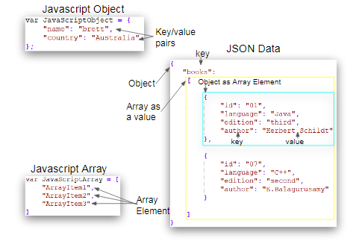
JSON Example
Notes:
Trenton

Slide 4
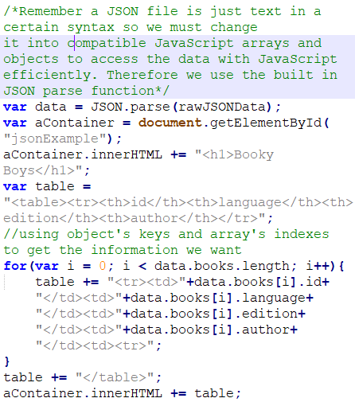
JSON Example
Accessing JSON Data
Notes:
Trenton

Slide 5
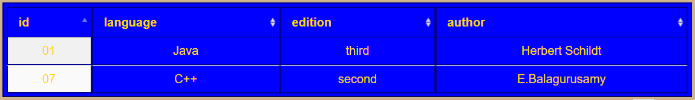
Examples Output

Slide 6
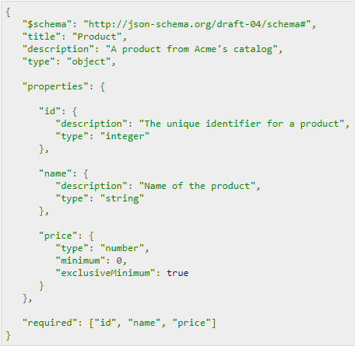
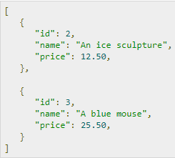
JSON Schema Example
Notes:
Trenton

Slide 7
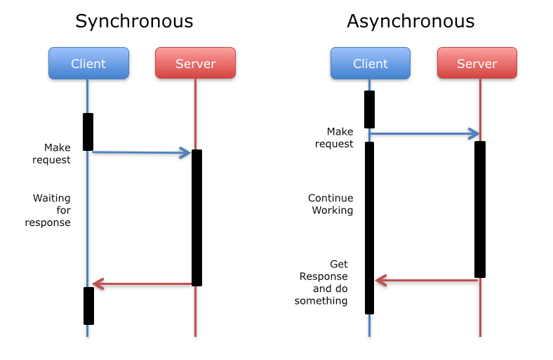
Synchronous vs. Asynchronous
Waits for one task to be executed completely before moving on to the next.
Moves onto other task whether or not the earlier task has been executed completely.
Notes:
Eden

Slide 8
AJAX
Asynchronous
Javascript
And
XML (JSON in our case)
What is it and what can it be used for?
AJAX is a way to receive and retrieve data asynchronously from web servers.
AJAX can be used to update a webpage with information from a web server in real time.
Why is it used?
AJAX allows a page to be updated without refreshing it.
Notes:
Eden

Slide 9
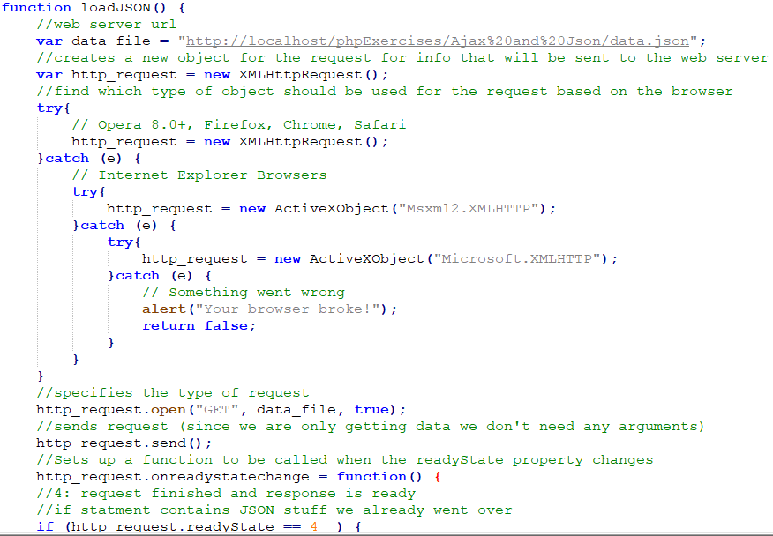
AJAX Example
Notes:
Trenton

Slide 10
Summary
JSON
Universal syntax for data organization using JavaScript object and array syntaxes.
JSON Schema
Instructions on the format of a JSON file
AJAX
A method to making asynchronous web pages with JavaScript
Synchronous
Task has to end before starting a new one
Asynchronous
Multiple tasks can run at the same time before one or the other is finished

Slide 11
Sources
https://www.w3schools.com/js/js_json_intro.asp
https://www.w3schools.com/js/js_ajax_intro.asp
https://www.quackit.com/json/tutorial/what_is_json.cfm
https://www.tutorialspoint.com/json/json_ajax_example.htm
https://stackoverflow.com/questions/244777/can-comments-be-used-in-json

Slide 12

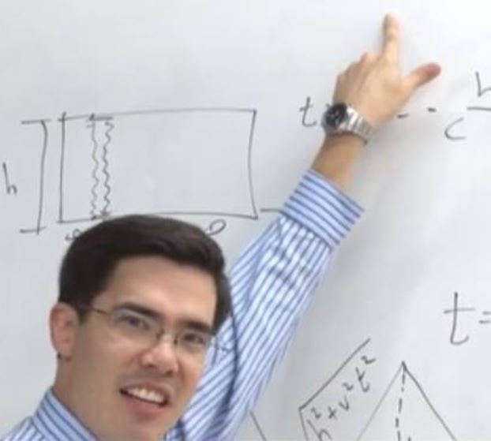
Time for the ol' Razzle Dazzle
[RAZZLE DAZZLE]
When you ask what time it is
Notes:
The Grand Seniors (Porter and Eden)

